Slide 1
Trinitarianism
ST5102
Dallas Theological Seminary
John Dyer

Slide 2
Question or Section Title

Slide 3
Text Slide Title
Please feel free to use these colors, icons, and slide templates in your own teaching.
The title font is Didot
The text font is Avenir
The Slide Master has three main colors embedded
Blue/Father
Red/Son
Yellow/Spirit

Slide 4
Origins

Slide 5
Economic Trinity

Slide 6
Perichoresis
I am in the Father, and the Father is in me. John 14:11
that all of them may be one, Father, just as you are in me, and I am in you. John 17:21

Slide 7
Title Slide
Busy background text

Slide 8
What is a father?
#3fc7ff
#2c0058
https://duotone.shapefactory.co/?i=lDLcG9RZFlk&f=3fc7ff&t=2c0058&q=parents
How does our experience / understanding of fatherhood shape our view of God as father?
What is the role of father in different cultures: Asian, Middle Eastern, African American, European, mixed race American?
How do our parents affect our parenting?

Slide 9
Fatherhood by the Numbers
There are 72.8 million children in the US (2020)
1 in 4 live (18.3m) live without a biological, step, or adoptive father in the home
There are 2 million single father households and 10 million single mother households
https://www.fatherhood.org/

Slide 10
The Messiah Is Born
#ff3f3f
#582800
https://duotone.shapefactory.co/?f=ff3f3f&t=582800&q=israel
¹⁸ This is how the birth of Jesus the Messiah (Χριστός christos) came about: His mother Mary was pledged to be married to Joseph, but before they came together, she was found to be pregnant through the Holy Spirit.
Matthew 1:18

Slide 11
The Messiah Is Born
#ff3f3f
#582800
https://duotone.shapefactory.co/?f=ff3f3f&t=582800&q=israel
In the beginning was the Word, and the Word was with God, and the Word was God.
The Word became flesh and made his dwelling (tabernacled) among us. We have seen his glory, the glory of the one and only Son, who came from the Father, full of grace and truth.
John 1:1,14

Slide 12
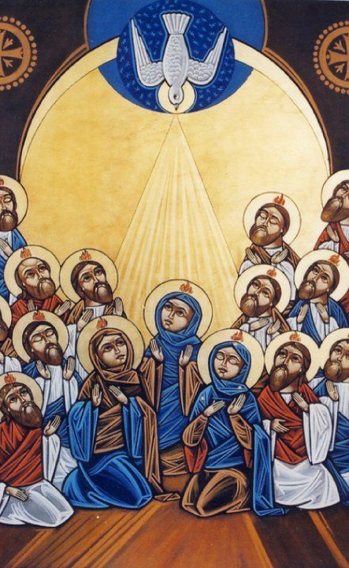
What or Who?
#ff3f3f
#582800
https://duotone.shapefactory.co/?f=ff3f3f&t=582800&q=israel
Is the Holy Spirit the impersonal power of God?
Is the Spirit an it or a he? A thing or a person?
What is the power of the spirit? Who can have it and why?
What is “blasphemy of the spirit” and why is it worse?
What is indwelling of the Spirit?

Slide 13
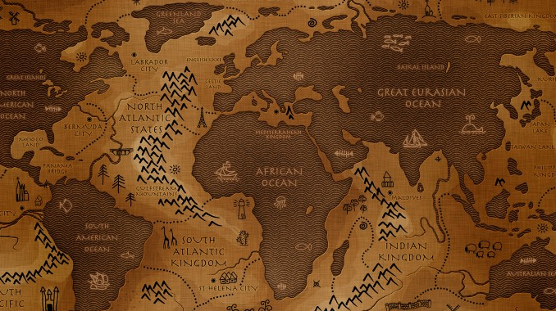
The (multi-ethnic) Nicene Creed
Council of Nicaea (325)
Council of Constantinople (381)
Long before colonialism, delegates from the Middle East, Europe, Africa, and as far as India, gathered to affirm the core truths of our faith.
Notes:
- One God
- We believe
- true God from God,
- begotten 2 things: not made
- maker = through him all things were made

Slide 14
The Nicene Creed (381)
We believe in one God, the Father, the Almighty, maker of heaven and earth, of all that is, seen and unseen.
We believe in one Lord, Jesus Christ, the only Son of God, begotten of the Father, God from God, Light from Light, true God from true God, begotten, not made, of one Being with the Father. …
We believe in the Holy Spirit, the Lord, the giver of life, who proceeds from the Father and the Son. With the Father and the Son, he is worshiped and glorified.
Notes:
- One God
- We believe
- true God from God,
- begotten 2 things: not made
- maker = through him all things were made

Slide 15
The Creed of Nicaea (325) – 1/2
We believe in one God, the Father, All Governing creator of all things visible and invisible.
And in one Lord Jesus Christ, the Son of God, begotten from the Father as only begotten, that is, from the essence of the Father [ek tēs ousias tou patros], God from God, Light from Light, true God from true God, begotten not created, of the same essence as the Father (homoousion tō patri], through whom all things came into being, both in heaven and in earth; Who for us men and for our salvation came down and was incarnate, becoming human.
Notes:
- One God
- We believe
- true God from God,
- begotten 2 things: not made
- maker = through him all things were made

Slide 16
The Creed of Nicaea (325) – 2/2
He suffered and the third day he rose, and ascended into the heavens. And he will come to judge both the living and the dead.
And [we believe] in the Holy Spirit.
But, those who say, Once he was not, or he was not before his generation, or he came to be out of nothing, or who assert that he, the Son of God, is of a different hypostasis or ousia, or that he is a creature, or changeable, or mutable, the Catholic and Apostolic Church anathematizes them.
Notes:
- scripture
- where is jesus
- giver of life
- activity of spirit = divine

Slide 17
The Creed of Constantinople (381) – 1/3
We believe in one God, the Father, the Almighty, maker of heaven and earth, of all that is, seen and unseen.
We believe in one Lord, Jesus Christ, the only Son of God, begotten of the Father, God from God, Light from Light, true God from true God, begotten, not made, of one Being with the Father. Through him all things were made. For us and for our salvation he came down from heaven: by the power of the Holy Spirit he became incarnate from the Virgin Mary, and was made man. For our sake he was crucified under Pontius Pilate;
Notes:
- One God
- We believe
- true God from God,
- begotten 2 things: not made
- maker = through him all things were made

Slide 18
The Creed of Constantinople (381) – 2/3
he suffered death and was buried. On the third day he rose again in accordance with the Scriptures; he ascended into heaven and is seated at the right hand of the Father. He will come again in glory to judge the living and the dead, and his kingdom will have no end.
We believe in the Holy Spirit, the Lord, the giver of life, who proceeds from the Father [and the Son]. With the Father and the Son he is worshiped and glorified. He has spoken through the Prophets.
Notes:
- scripture
- where is jesus
- giver of life
- activity of spirit = divine

Slide 19
The Creed of Constantinople (381) – 3/3
We believe in one holy catholic and apostolic Church. We acknowledge one baptism for the forgiveness of sins. We look for the resurrection of the dead, and the life of the world to come. Amen.
The version of the Creed is that of the International Consultation on English Texts, the form adopted by the Ancient Christian Doctrine series. See Thomas Oden, “General Introduction,” ACD, 1.xviii–xix. The brackets around the controversial filioque clause [“and the Son”] are my addition.
Notes:
00:00:00

Slide 20
Nicaea/Constantinople Comparison – 1/3
First Council of Nicaea (325) | First Council of Constantinople (381)
We believe in one God, the Father Almighty, Maker of all things visible and invisible. | We believe in one God, the Father Almighty, Maker of heaven and earth, and of all things visible and invisible.
And in one Lord Jesus Christ, the Son of God, begotten of the Father [the only-begotten; that is, of the essence of the Father, God of God,] Light of Light, very God of very God, begotten, not made, consubstantial with the Father; | And in one Lord Jesus Christ, the only-begotten Son of God, begotten of the Father before all worlds, Light of Light, very God of very God, begotten, not made, consubstantial with the Father;
By whom all things were made [both in heaven and on earth]; | by whom all things were made;
Notes:
00:00:00

Slide 21
Nicaea/Constantinople Comparison – 2/3
First Council of Nicaea (325) | First Council of Constantinople (381)
Who for us men, and for our salvation, came down and was incarnate and was made man; | who for us men, and for our salvation, came down from heaven, and was incarnate by the Holy Ghost and of the Virgin Mary, and was made man;
He suffered, and the third day he rose again, ascended into heaven; | he was crucified for us under Pontius Pilate, and suffered, and was buried, and the third day he rose again, according to the Scriptures, and ascended into heaven, and sitteth on the right hand of the Father;
Notes:
00:00:00

Slide 22
Nicaea/Constantinople Comparison – 3/3
First Council of Nicaea (325) | First Council of Constantinople (381)
And in the Holy Ghost. | And in the Holy Ghost, the Lord and Giver of life, who proceedeth from the Father, who with the Father and the Son together is worshiped and glorified, who spake by the prophets.
[But those who say: ‘There was a time when he was not;’ and ‘He was not before he was made;’ and ‘He was made out of nothing,’ or ‘He is of another substance’ or ‘essence,' or ‘The Son of God is created,’ or ‘changeable,’ or ‘alterable’— they are condemned by the holy catholic and apostolic Church.] | In one holy catholic and apostolic Church; we acknowledge one baptism for the remission of sins; we look for the resurrection of the dead, and the life of the world to come. Amen.
Notes:
00:00:00

Slide 23
The Athanasian Creed (1/5)
Whosoever will be saved, before all things it is necessary that he hold the catholic faith, which except everyone shall have kept whole and undefiled, without doubt he will perish eternally. Now the catholic faith is this: We worship One God in Trinity and Trinity in Unity, neither confounding the Persons nor dividing the substance.
For there is one Person of the Father, another of the Son, another of the Holy Spirit. But the Godhead of the Father, of the Son, and of the Holy Spirit, is One, the Glory equal, the Majesty co-eternal.
Notes:
00:00:00

Slide 24
The Athanasian Creed (2/5)
Such as the Father is, such is the Son, and such is the Holy Spirit; the Father is uncreated, the Son is uncreated, and the Holy Spirit is uncreated; the Father is infinite, the Son is infinite, and the Holy Spirit is infinite; the Father eternal, the Son eternal, and the Holy Spirit eternal. And yet there are not three eternals but one eternal, as also not three infinites, nor three uncreateds, but one uncreated, and one infinite.
Notes:
00:00:00

Slide 25
The Athanasian Creed (3/5)
So, likewise, the Father is almighty, the Son almighty, and the Holy Spirit almighty; and yet not three almighties but one almighty. So the Father is God, the Son God, and the Holy Spirit God; and yet not three Gods but one God. So the Father is Lord, the Son Lord, and the Holy Spirit Lord; and yet not three Lords but one Lord. For like as we are compelled by Christian truth to acknowledge every Person by Himself to be both God and Lord; so are we forbidden by the catholic religion to say, there be three Gods or three Lords.
Notes:
00:00:00

Slide 26
The Athanasian Creed (4/5)
The Father is made of none, neither created nor begotten. The Son is of the Father alone, not made nor created but begotten. The Holy Spirit is of the Father and the Son, not made nor created nor begotten but proceeding. So there is one Father not three Fathers, one Son not three Sons, and one Holy Spirit not three Holy Spirits.
Notes:
00:00:00

Slide 27
The Athanasian Creed (5/5)
And in this Trinity there is nothing before or after, nothing greater or less, but the whole three Persons are coeternal together and coequal.
So that in all things, as is aforesaid, the Trinity in Unity and the Unity in Trinity is to be worshiped. He therefore who wills to be in a state of salvation, let him think thus of the Trinity.
Named in honor of the great Trinitarian father (295/300–373), the Athanasian Creed (or “Quicunque Vult”) is of disputed origins, likely composed sometime after 450, probably in southern Gaul and widely used as a Latin catachism.
Notes:
00:00:00

Slide 28
Oneness
Threeness
Consubstantiality
Simplicity
Inseparable Operations
Perichoresis
Processions
Persons
Missions
Communion

Slide 29
Consubstantiality
Of the same substance or essence
Latin: consubstantialis; Greek: homoousios (ὁμοούσιος)
“The Son is consubstantial with the Father” (creeds)
The Father, Son, and Spirit each have what is necessary to count as fully and equally divine
And yet … they are not divided into distinct substances
Nor are they identical or an absolute numerical unity
At the level of person, hypostatis, and relation, they are distinct
Meaning: the Father, Son, and Spirit are equally worshipped

Slide 30
Processions
How can we distinguish Father, Son, and Spirit without violating or undermining consubstantiality?
Procession: the eternal origin of the Son and Spirit from the Father (i.e., how they are consubstantial)
Almost all theologians use “eternal generation” for Father/Son, but sometimes use different terms for Father(Son)/Spirit
“Today I have begotten you” (Ps 2:7, Acts 13:13; Heb 1:5; 5:5)
“God has sent the Spirit of the Son” (Gal 4:6)
Hypostasis: a mode of subsistence of the nature, has a personal property, Father: unbegotten, Son: begotten, Spirit: sentness
Notes:
“Before the hills, I was brought forth” (Prov 8:25, 1 Cor 1:30)

Slide 31
Simplicity
God is not composed of parts and is indivisible
God is not one of a category or genus
God doesn’t “have” attributes: “God is by nature what he is, but he is called by us such names as the poverty of our nature will allow us to make use of” – Gregory of Nyssa (our limited minds think in categories/attributes, but he is one)
“God is spirit” (John 4:24)
“God does not change like shifting shadows” (James 1:17)

Slide 32
Persons
Latin: personae could mean “role in a theatre” “the person of a verb in grammar” or an “individual in a social sense”
Greek: prospon “face” “to gaze” “that which is seen”
Hypostatis: a concrete subsistence of a nature Person: the manner in which the subsistence presents itself
Boethius: “an individual substance of a rational nature”
Today, persons are known for their individuality, but theological persons are defined in relation to others
Divine Person: a unique subsistence of the one rational divine nature distinguished from other persons by their relations
Notes:
Subsistence – could apply to rocks
Boethius – only rational?

Slide 33
Inseparable Operations
All three persons of the Holy Trinity are at work in every action outside of the Trinity’s life. The identity of Yahweh is one.
Hear, O Israel: The Lord our God, the Lord is one. (Deut 6:4)
Prepare the way of the Lord (Matt 3:3; Isaiah 40:3 “Lord”)
Christ is not alongside the Father, as a secondary agent. God is not a collective or a cooperation, but unified in all actions.
On the cross, the Father doesn’t punish the Son, but the Son’s humanity suffers
Scripture appropriates actions to persons based on relations: Creation from the unbegotten Father, through the Begotten Son, by the Send Spirit.
Notes:
But Jesus answered them, “My Father is working until now, and I am working.” (John 5:17)

Slide 34
Missions
Th sending of the Son and the Spirit to the world
An extension of divine processions, where in the Persons become present to creation in a new manner, reuniting them with God.
Not a command from one will to another, for all come.
Jesus answered him, “If anyone loves me, he will keep my word, and my Father will love him, and we will come to him and make our home with him.” (John 14:23)

Slide 35
Perichoresis
From Greek peri "around" and chōreō "to go, or come”
”The Father is in Me and I am in the Father” (John 14:10; 17:21)
The interpenetration of the Father, Son, and Spirit, as distinct relationally, but inseparable in nature
“Mutual indwelling/divine sharing” rather than “divine dance”
Also used in Christology (two natures), soteriology (in Christ), ecclesiology (one body), eschatology (God in all 1 Cor 15:28)
Distinction: Divine Perichoresis is eternal, mutual, whereas our union with God is asymmetric and yet incomplete

Slide 36
Communion
Our experience of the Triune God
From Greek koinonia (κοινωνία) meaning ”fellowship” ”sharing” or ”participation”
Co-ordinate mode: praise to the Father, praise to the Son, praise to the Spirit, three in one.
Risk: lack of uniqueness of the persons
Linear model: Our fellowship with the Father, through the Son, in the Spirit.
Risk: one person becomes primary, others subordinative. Pentecostals start with the Spirit, evangelicals emphasize the Son, etc.
We are called into communion with one God in three persons!

Slide 37
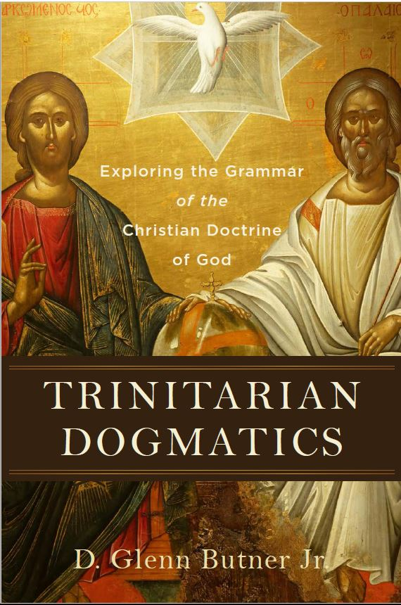
Trinitarian Dogmatics
If all worship of God must be in Spirit and in truth (John 4:24), and if there is but one Spirit who is worshiped and one Son who is himself truth (John 14:6), then all worship is fundamentally trinitarian-in its object, as three divine persons are addressed; in its structure, as worship proceeds in the Spirit through the Son to the Father; and in its mode, as Christians enabled by the indwelling Holy Spirit are incorporated into spiritual communion with Father, Son, and Spirit.
Glenn Butner

Slide 38
Oneness
Threeness
Consubstantiality
Simplicity
Inseparable Operations
Perichoresis
Processions
Persons
Missions
Communion

Slide 39
Questions
Father
What makes the Father, the Father? Or the Son, the Son?
What do they have in common and what is different?
IS
IS NOT
GOD
IS NOT
IS
IS
Son
Holy
Spirit
IS NOT

Slide 40
Definitions
Attributes – shared aspects of the divine nature
Processions – relationships of origin between persons
Generation/Filiation – relationship of Father and Son
Spiration/Procession – relationship of Father+Son to Spirit

Slide 41
Processions
Begotten of the Father
“Today I have begotten you” (Ps 2:7, Acts 13:13; Heb 1:5; 5:5)
“For God so loved the world that he sent his only begotten Son” John 3:16
Sending of the Spirit
But the Advocate, the Holy Spirit, whom the Father will send in my name. John 14:25
And see, I [Jesus] am sending upon you what my Father promised. Luke 24:49
When the Counselor comes, the One I will send to you from the Father the Spirit of truth who proceeds from the Father–He will testify about Me. John 15:26

Slide 42
Models of the Procession of the Spirit
Father
Father
Father
Son
Holy
Spirit
Son
Holy
Spirit
Son
Holy
Spirit
Father only
(John 14:25)
Father and Son
(John 15:26)
Father through the Son

Slide 43
Trinitarian Processions/Relations
Father
Father
unbegotten, source of all things
Son – eternally begotten
(eternally) “begotten, not made”
Begotteness – relationship with the Father, same nature as the Father
Holy Spirit – eternally proceeds
Procession – relationship to Father and Son, activity in the world
Generation
(John 3:16)
Spiration
(John 14:25)
Son
Spiration
(Luke 24:49)
Holy
Spirit
Notes:
Equally share in divine nature, distinction comes in relation

Slide 44
Processions
Father
Processions
Paternity
Common Spiration
Relations
Filiation
Procession
Generation
(John 3:16)
Spiration
(John 14:25)
Son
Spiration
(Luke 24:49)
Holy
Spirit
Procession
Common Spiration

Slide 45
Definitions
Operation – God’s action in the world
Doctrine of Inseparable Operations – Father, Son, and Spirit always act in unity and singularity of will and purpose
Why does scripture seem to assign some actions to one person, like election to the Father (1 Pet. 1:1-2)?

Slide 46
Definitions
Processions – relationships of origin between persons
Operation – God’s (inseparable) actions in the world
Appropriations – Scripture assigning actions to a person based on their uniqueness.
How are the persons unique?
Their processions!

Slide 47
Appropriation in Salvation
Procession
Operation
Appropriation
Father
Source/Principle
Salvation
Predestination
(beginning)
Son
Generated by Father
Redemption
(sending)
Spirit
Spiration by the
Father and the Son
Sanctification (goal)

Slide 48
Appropriation in Creation
Procession
Operation
Appropriation
Father
Source/Principle
Creation
Creates
Son
Generated by Father
Through the Son
Spirit
Spiration by the
Father and the Son
By the Spirit

Slide 49
Appropriation in Revelation
Procession
Operation
Appropriation
Father
Source/Principle
Revelation
Revealer
Son
Generated by Father
Through the Word
Spirit
Spiration by the
Father and the Son
By the Spirit

Slide 50
Appropriation of Love (Augstine)
Procession
Operation
Appropriation
Father
Source/Principle
Love
Lover
Son
Generated by Father
Beloved
Spirit
Spiration by the
Father and the Son
Love

Slide 51
Church History Timeline
Early Church
(33-325)
Roman Empire
(325-476)
Early Middle Ages
(476-799)
Late Middle Ages
(800-1299)
Renaissance
(1300-1517)
Early Modern
(1517-1750)
Late
Modern
(1750-1919)
1
500
1000
1500
2000

Slide 52
Timeline: Early Church (33-324)
Constantinople (381)
Jesus Ascends (31/33)
Edict of Milan (313)
Rome Burns (64)
Nicaea (324)
Jerusalem Temple (70)
1
100
200
300
Theologians (150–)
Tertullian (“trinitas”)
Origen (“eternal generation”)
Synoptics
Mark/Matthew/Luke (60s)
Other Letters (60s)
Acts (60s)
Athanasius
Defender of Trinity
Fathers/Apologists (100-150)
Ignatius
Justin Martyr
Theophilus (“trias”)
Arianism (250)
Arius “a time when
the son was not”
Early Epistles
James (46)
Galatians (48)
Thessalonians (50)
Corinthians (55)
Romans (57)
1 Peter (60?)
Johannine
Gospel of John (80s)
1,2,3 John (90s)
Revelation (90+)
Cappadocians
Gregory of Nazianzus
Basil the Great

Slide 53
Middle Ages (325–1517)
Chalcedon (451)
East/West Split (1054)
Fall of Rome (476)
Crusades
(1095–1291)
Reformation (1517)
Pope Gregory
the Great (590)
Renaissance
(1300-)
300
500
1000
1500
Muhammad
(570–632)
Qu’ran Founder of Islam
Bohemian
Reformation
(1380-)
John Wycliff
Jan Huss Waldensians
Augustine
(354-430)
On the Trinity
City of God
Against Pelagius
Monasticism
Desert Fathers
Thomas Aquinas
(1225-1274)
Summa Theologica
Notes:
Monasticism
§ monastic “way” that involved some form of separation from the world and voluntary embrace of a set of rules for Christian discipline in daily living
GREGORY the GREAT (540-604 AD)
Institutionalized Roman church, organized papal system of government
training schools for church music, standardized liturgy
dominance of church as civil government and state
influenced key doctrines
missions activity

Slide 54
Late Modern (1700s-) +Evangelicalism
Azusa Street Revival (1904)
Jonathan
Edwards
(1703-1758)
1st Great
Awakening
Whitefield,
Wesleys (1770s)
Neo-Evangelicalism (1950s)
CT, Fuller, GCTS
2nd 3rd Great Awakenings
Bible Conference Movement
Wheaton (1860)
Carter (1976)
1700
1800
1900
2000
Enlightenment
Death of Louis XIV of
France (1715)
French Revolution (1789)
Religious
Right
(1980)
Moral Majority
Descartes
(1637)
cogito, ergo sum
Newton
(1687)
Principia Mathematica
Schleiermacher Christian Faith (1821)
Scopes Monkey Trail Clarence Darrow (1924)

Slide 55
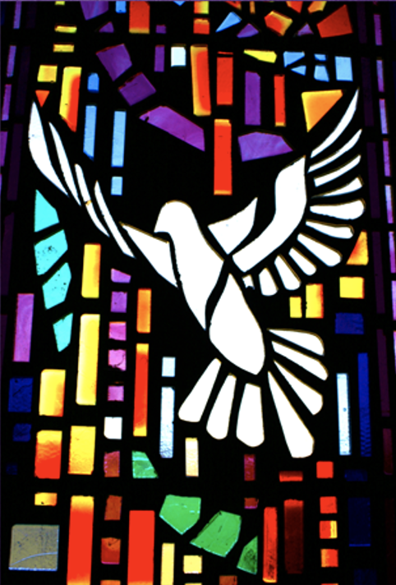
Triune Patterns
Worship: ”Holy, holy, holy” we worship Father, Son, and Spirit
Prayer: “Pray to your Father” to the Father, through the Son, by the Spirit
Scripture: “breathed by the Spirit” we read scripture as trinitarian
Practice: “Baptize in the NAME …” we baptize in Father, Son, and Spirit
Discipleship: “Teaching them all …” The gospel is the triune story of God the Father sending the Son and the Spirit

Slide 56
Trinitarian Hermeneutics
Romans 10:8,10
⁹ If you declare with your mouth, “Jesus is Lord,” and believe in your heart that God raised him from the dead, you will be saved. ¹⁰ For it is with your heart that you believe and are justified, and it is with your mouth that you profess your faith and are saved... ¹³ for, “Everyone who calls on the name of the Lord will be saved.”(Joel 2:32)
Joel 2:32
And everyone who calls on the name of the Lord will be saved;
shema yhwh = name of Yahweh (Hebrew)
onoma kyriou = name of the Lord (Greek NT and OT)

Slide 57
Trinitarian Grammar
Go therefore and make disciples of all the nations, baptizing them in the name of the Father and the Son and the Holy Spirit.
Matthew 28:19-20
Notes:
00:00:00

Slide 58
Trinitarian Grammar
Go therefore and make disciples of all the nations, baptizing them in the name of (oneness of God) the Father and the Son and the Holy Spirit. (distinct persons)
Matthew 28:19-20
Notes:
00:00:00

Slide 59
Trinitarian Grammar
There is one body and one Spirit, just as you were called to one hope when you were called; one Lord, one faith, one baptism; one God and Father of all, who is over all and through all and in all.
Ephesians 4:4-6
Notes:
00:00:00

Slide 60
God’s Self Revelation
Councils
East/West Split
The Reformation
Moses
Bathsheba
Abraham
David
Prophets
Hagar
Rahab
Huldah
This Class
2000
1500
1000
500
1AD
500
1000
1500
2000
God is one.
God will work through Israel.
Divine plurality.
The messiah will come (is divine?)
We baptize in the name of Father, Son, and Spirit.
We worship Jesus as Lord and God.
One nature, three persons. One person,
Two natures.
Old Testament
New Testament
Creedal Language

Slide 61
The Trinity is the Gospel The Gospel is the Trinity
Four Spiritual Laws
God loves you
You have sin
Jesus died for you
You believe
The Triune Gospel Story
The God of relational love expanded himself, saying “Let us make humans in our image”
Humans broke this loving fellowship, turning inward on themselves
God the Father sent God the Son to take on human nature and bear the burden of evil and suffering
When you believed, you were marked in him with a seal, the promised Holy Spirit

Slide 62
Images of the Spirit
Fire cleansing
Wind moving
Dove descending
Oil anointing
Notes:
Oil: https://www.biola.edu/blogs/good-book-blog/2016/metaphors-revealing-the-holy-spirit-part-3-oil-as-a-metaphor-for-the-holy-spirit

Slide 63
Fire
John answered them all, “I baptize you with water. But one who is more powerful than I will come, the straps of whose sandals I am not worthy to untie. He will baptize you with the Holy Spirit and fire. Matt 3:11; Luke 3:16

Slide 64
Wind
The wind (pneuma) blows wherever it pleases. You hear its sound, but you cannot tell where it comes from or where it is going. So it is with everyone born of the Spirit (pneuma). John 3:8

Slide 65
Dove
As soon as Jesus was baptized, he went up out of the water. At that moment heaven was opened, and he saw the Spirit of God descending like a dove and alighting on him. Matthew 3:16

Slide 66
Oil
So Samuel took the horn of oil and anointed him in the presence of his brothers, and from that day on the Spirit of the Lord came powerfully upon David. Samuel then went to Ramah. 1 Sam 16:13

Slide 67
Rationalism vs. Faith Seeking Understanding
Fragile Faith
Freedom to explore understanding through reason
The Bible is trustworthy
Trust in God’s word
Rationalism: History and science prove the Bible is trustworthy
Humble Faith
Starting Point

Slide 68
Honeycomb Alternate
Created by John Dyer
https://twitter.com/johndyer
https://j.hn/
Please feel free to use any or all of this. Blessings!

